Slide 1

TBI – A Field Moving from Competition
to Collaboration
Geoffrey Manley, MD, PhD, on behalf of the
TRACK-TBI and TED Investigators
manleyg@ucsf.edu

Slide 2

Traumatic Brain Injury: 2015
Classification
GCS
(Glasgow Coma Scale)
Outcome
GOS
(Glasgow Outcome Scale)
Severe
Vegetative
Death
Mild
Concussion
Good Recovery
A Complex and Heterogeneous Disease

Slide 3
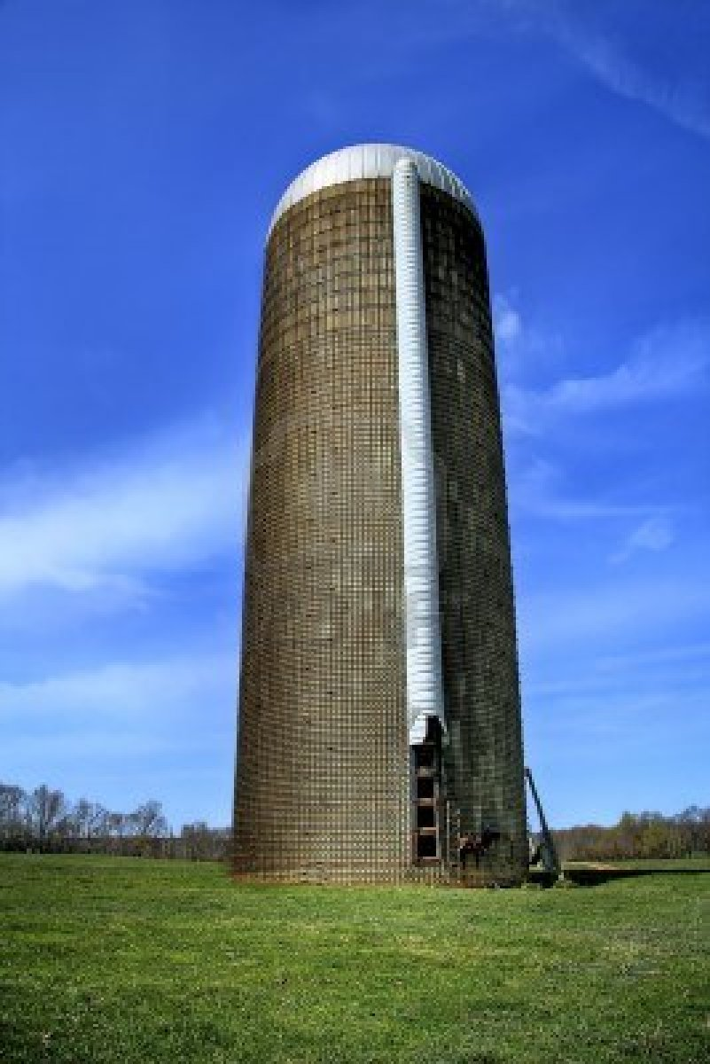

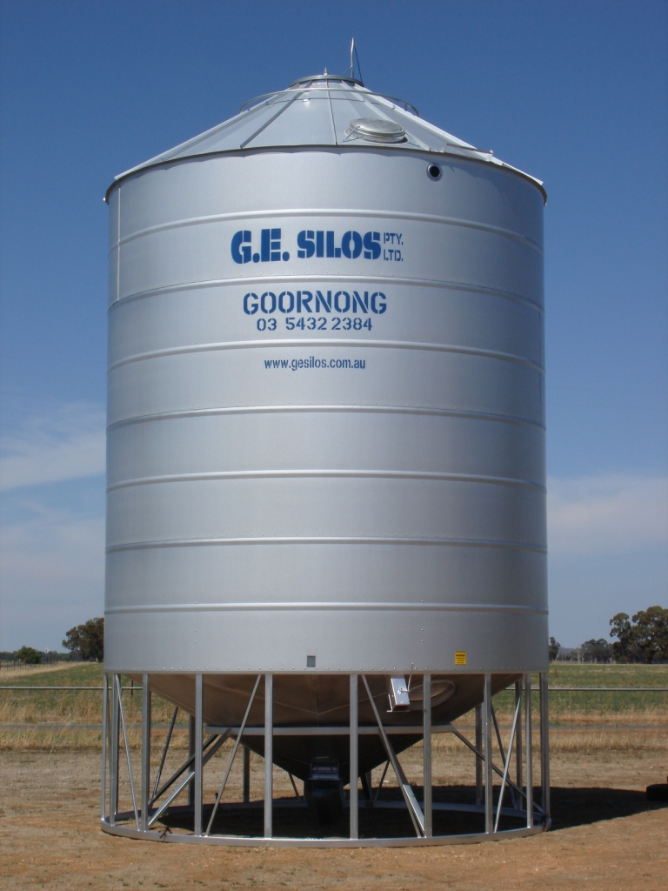

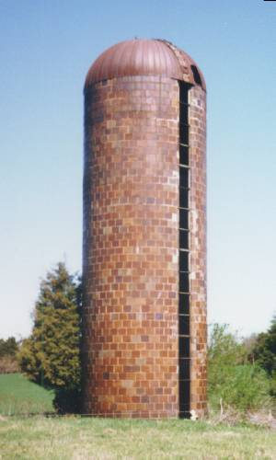

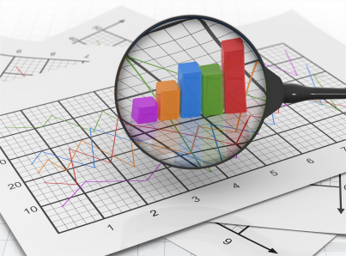

Old Model - Competition
Silos
Papers
Grants
IP
Money
No single investigator, institution, or company can solve this problem
Why don’t we just share the data?

Slide 4

Data Sharing Is Harder Than You Think
Most current incentives encourage hoarding of data
Authorship
Funding, Recognition, and Promotion
Publication Policies
IP, Money

Slide 5
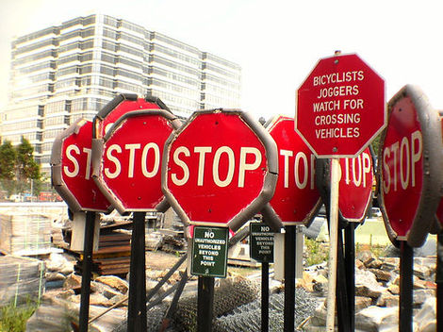
Papers
Grants
IP
Money
Accelerate Research
Create Knowledge
Improve Outcome

Slide 6
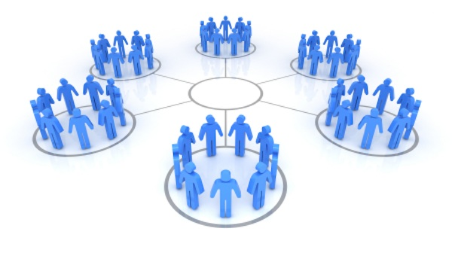
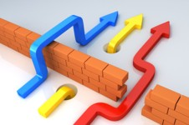
Collaboration
Early and Open with Shared Rewards

Slide 7
How to Establish a Culture of Collaboration: Team Science and Communication
Shared leadership responsibility, decision-making authority, data, and credit
Each member brings specific expertise
Regular interactive meetings – virtual and in-person

Slide 8
How to Establish a Culture of Collaboration:
Circumvent Barriers
Publication and Authorship Guidelines
Data Use Agreement (data in/ data out)
Collaboration Agreement (Academ/Private)
Analysis plans posted for sharing among collaborators
Guarantee shared rewards
and promote collaboration

Slide 9
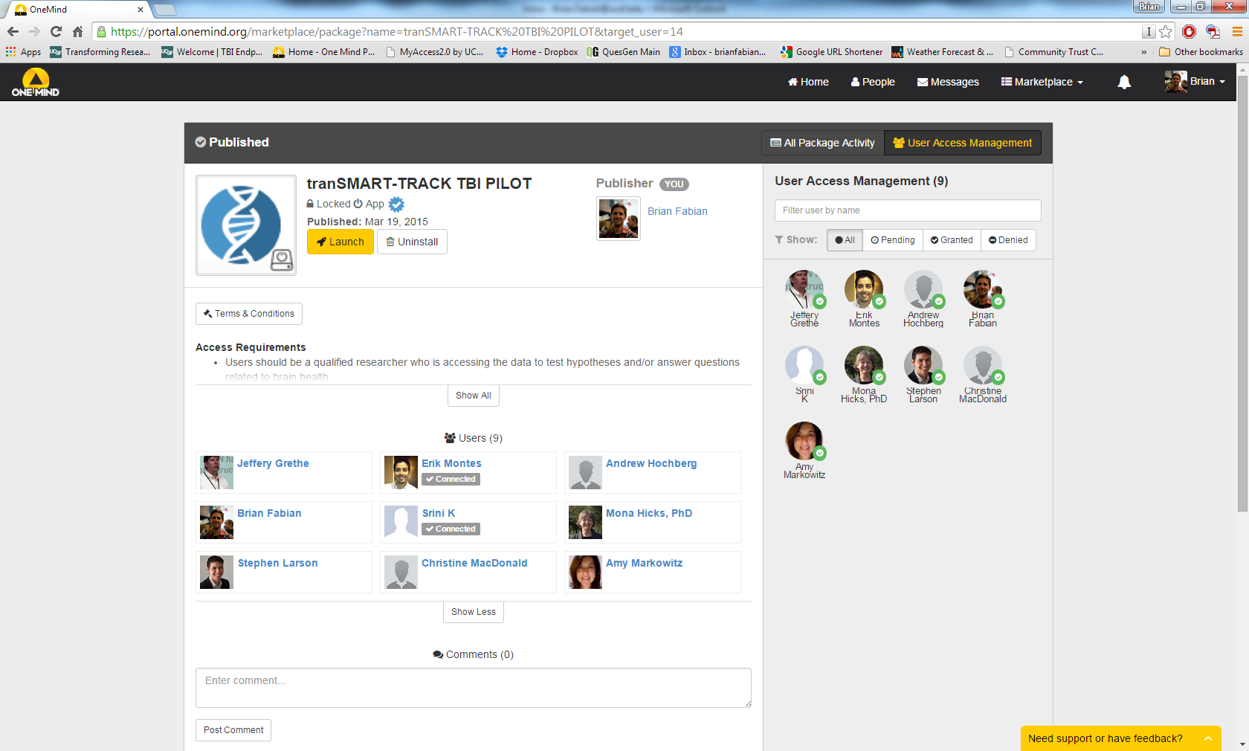

One Mind Portal

Slide 10
Is this Model of Collaboration
Working ?

Slide 11

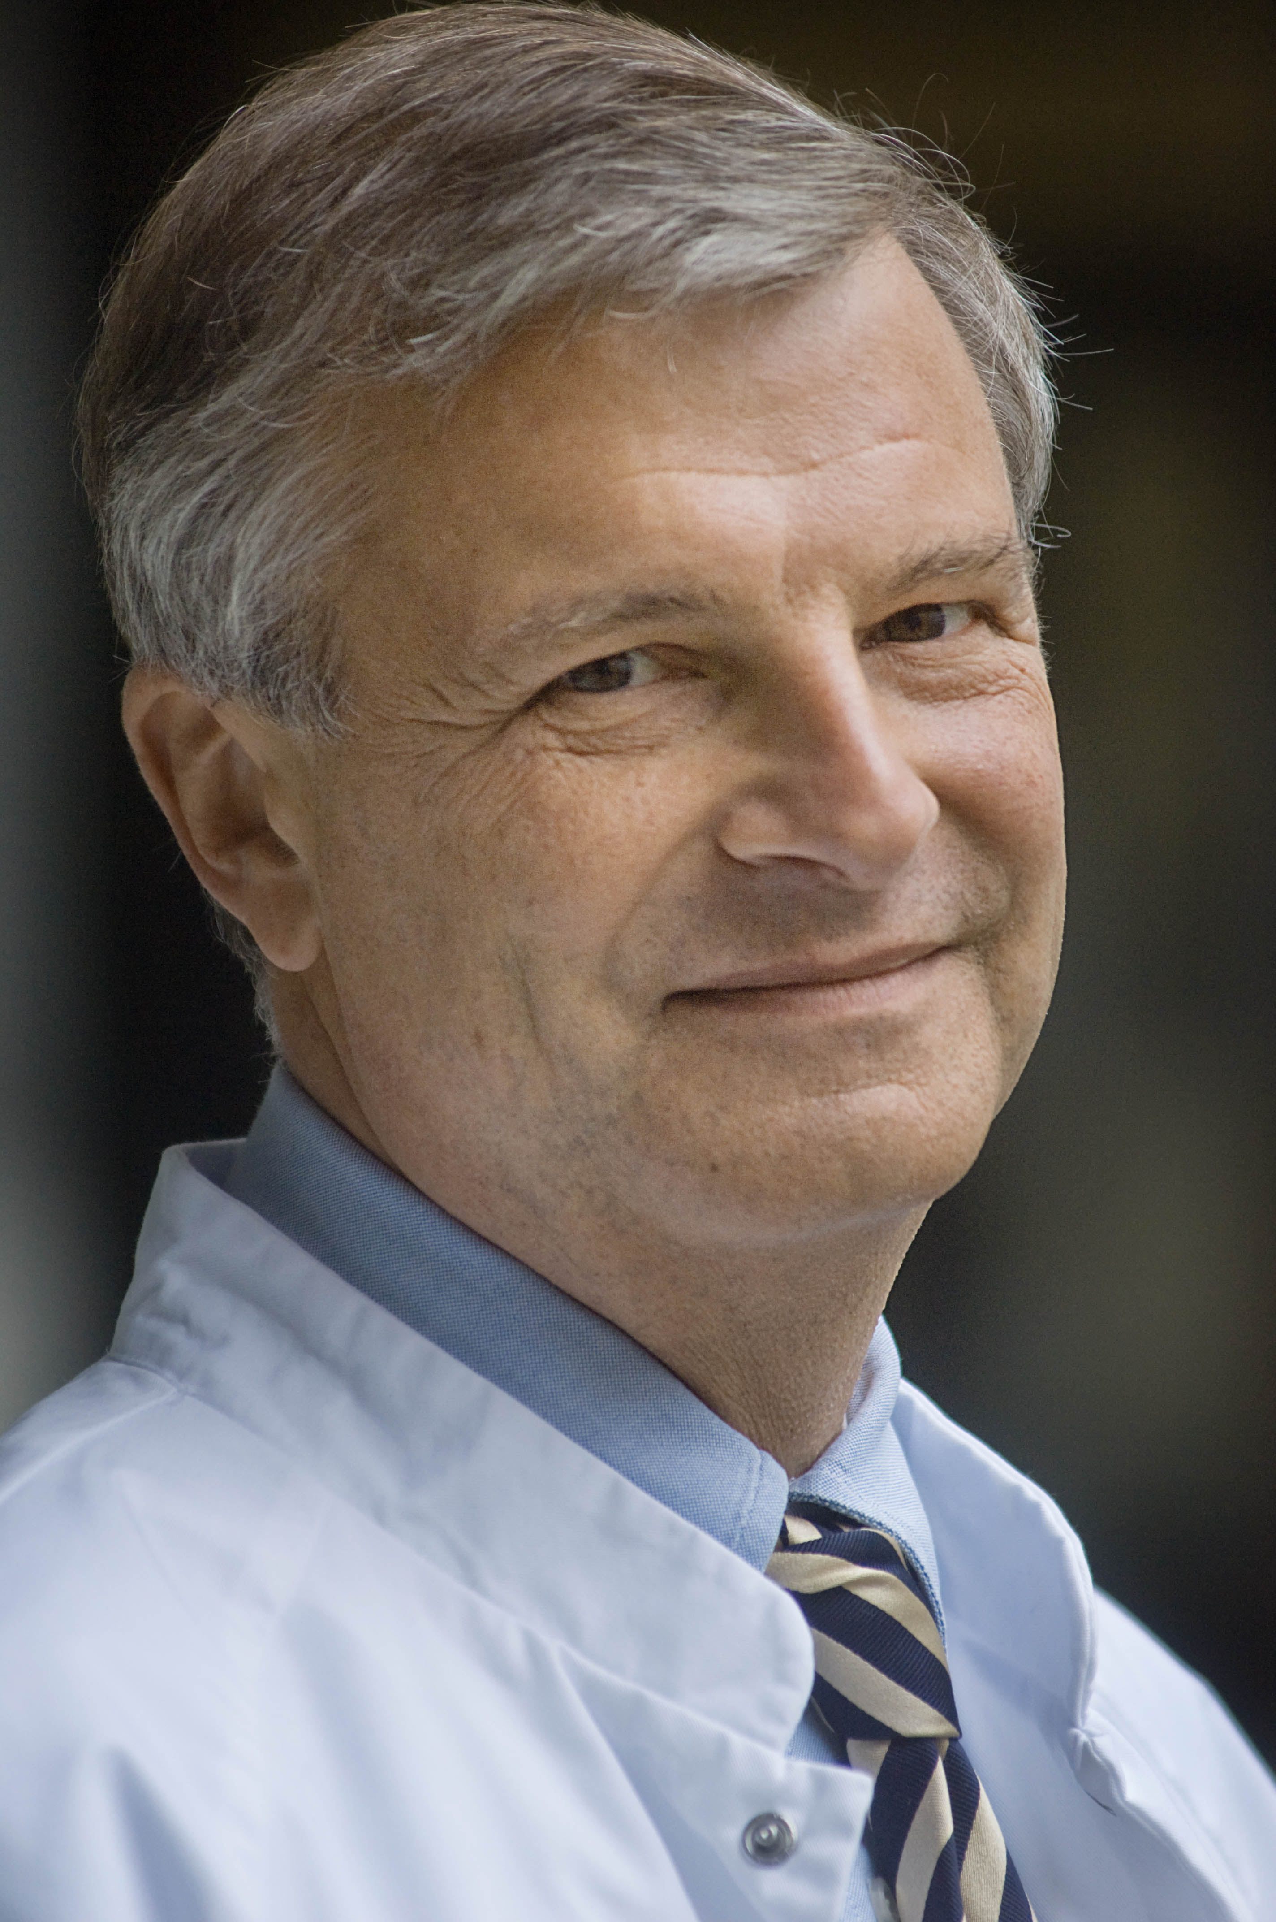
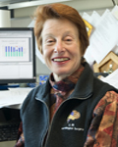
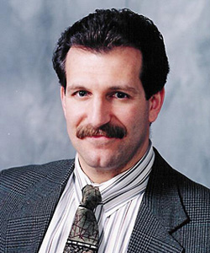
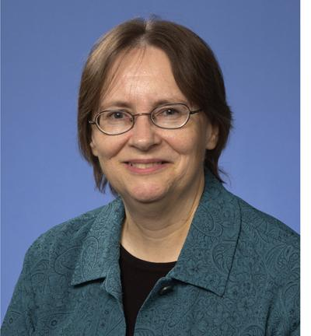
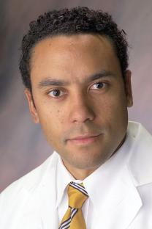
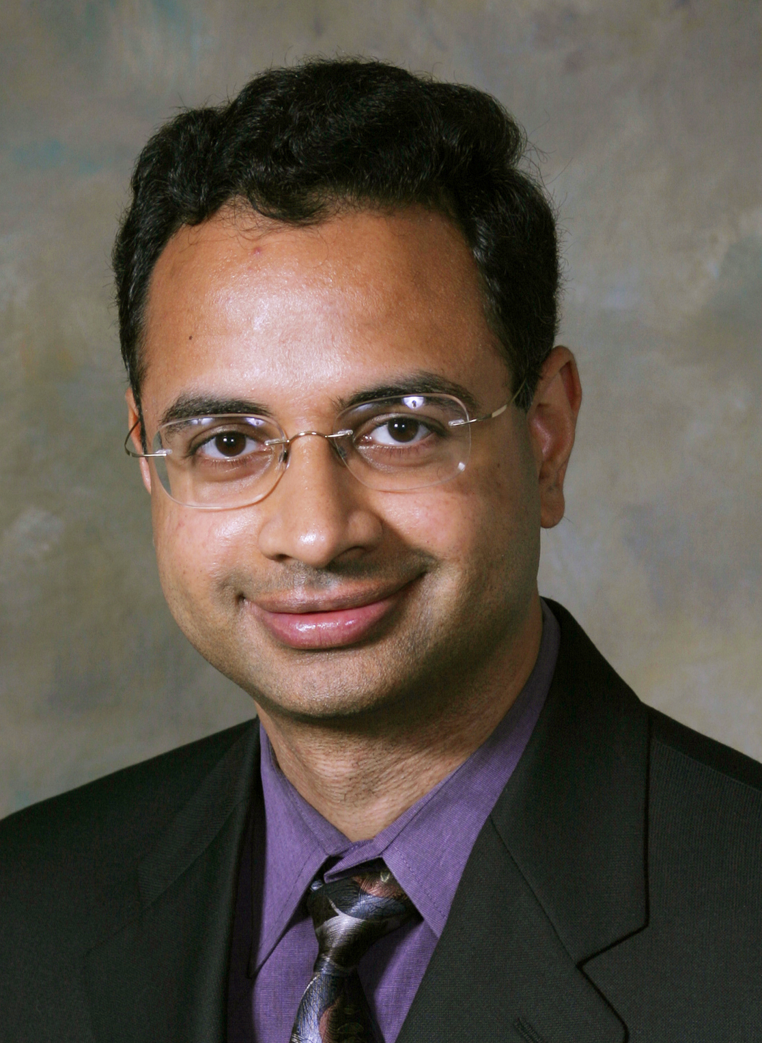
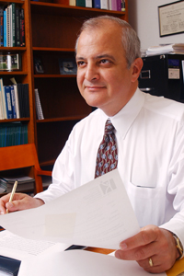
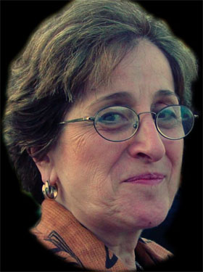
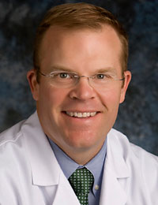
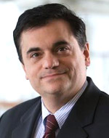
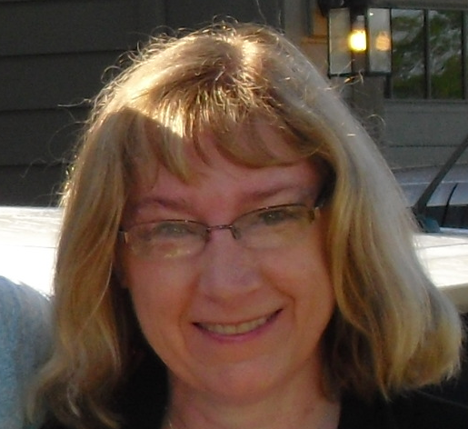

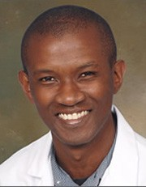

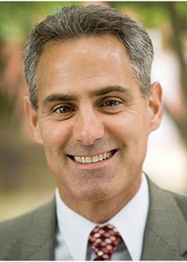
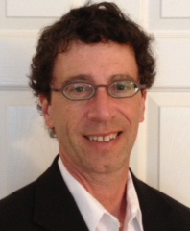
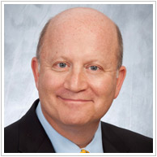
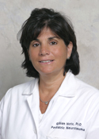
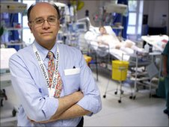
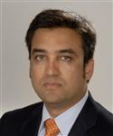
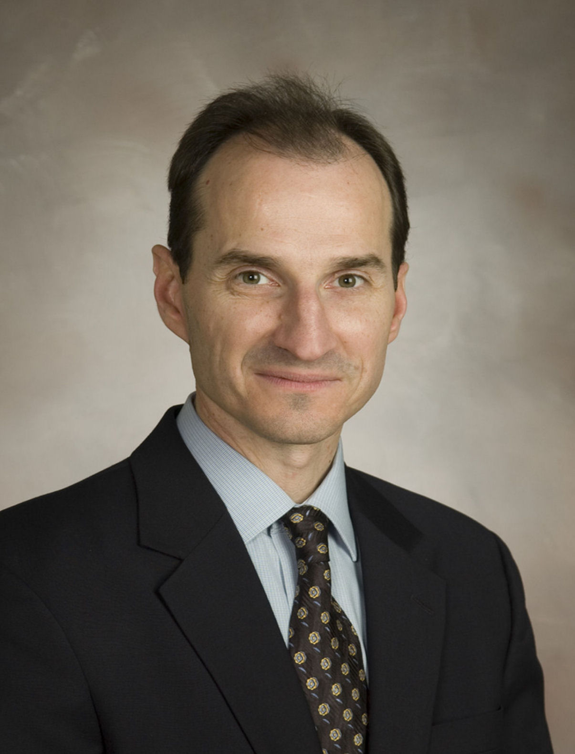

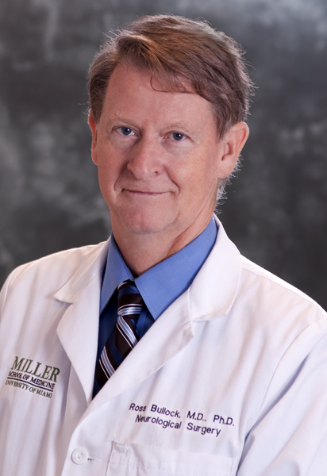
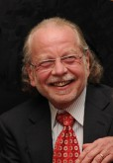
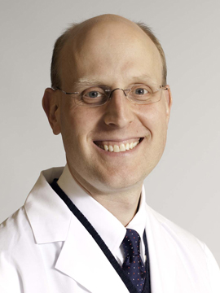
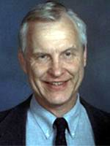
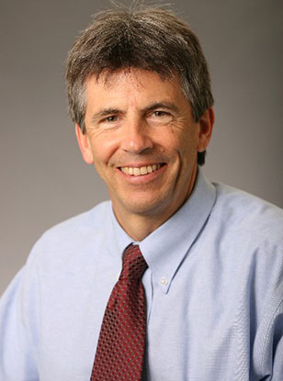
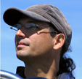
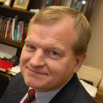
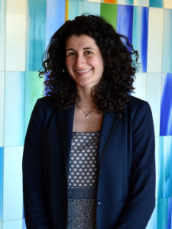
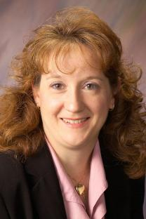
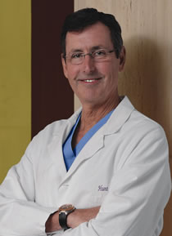
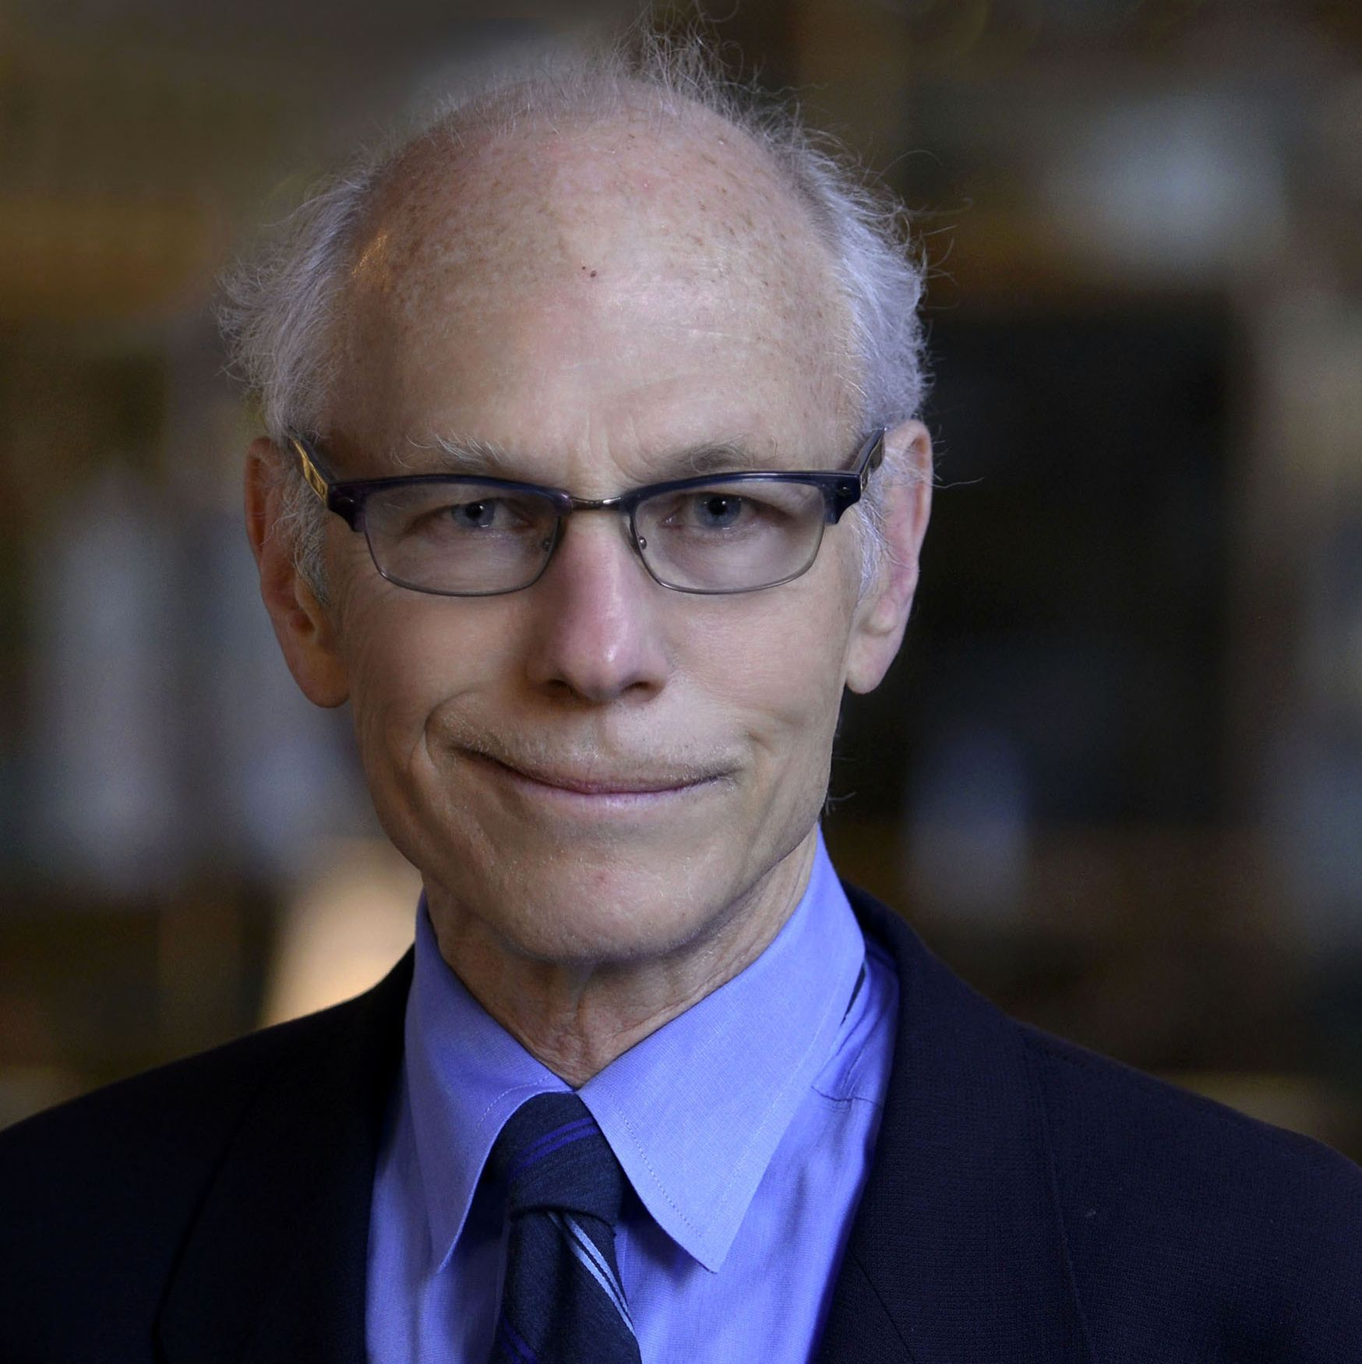
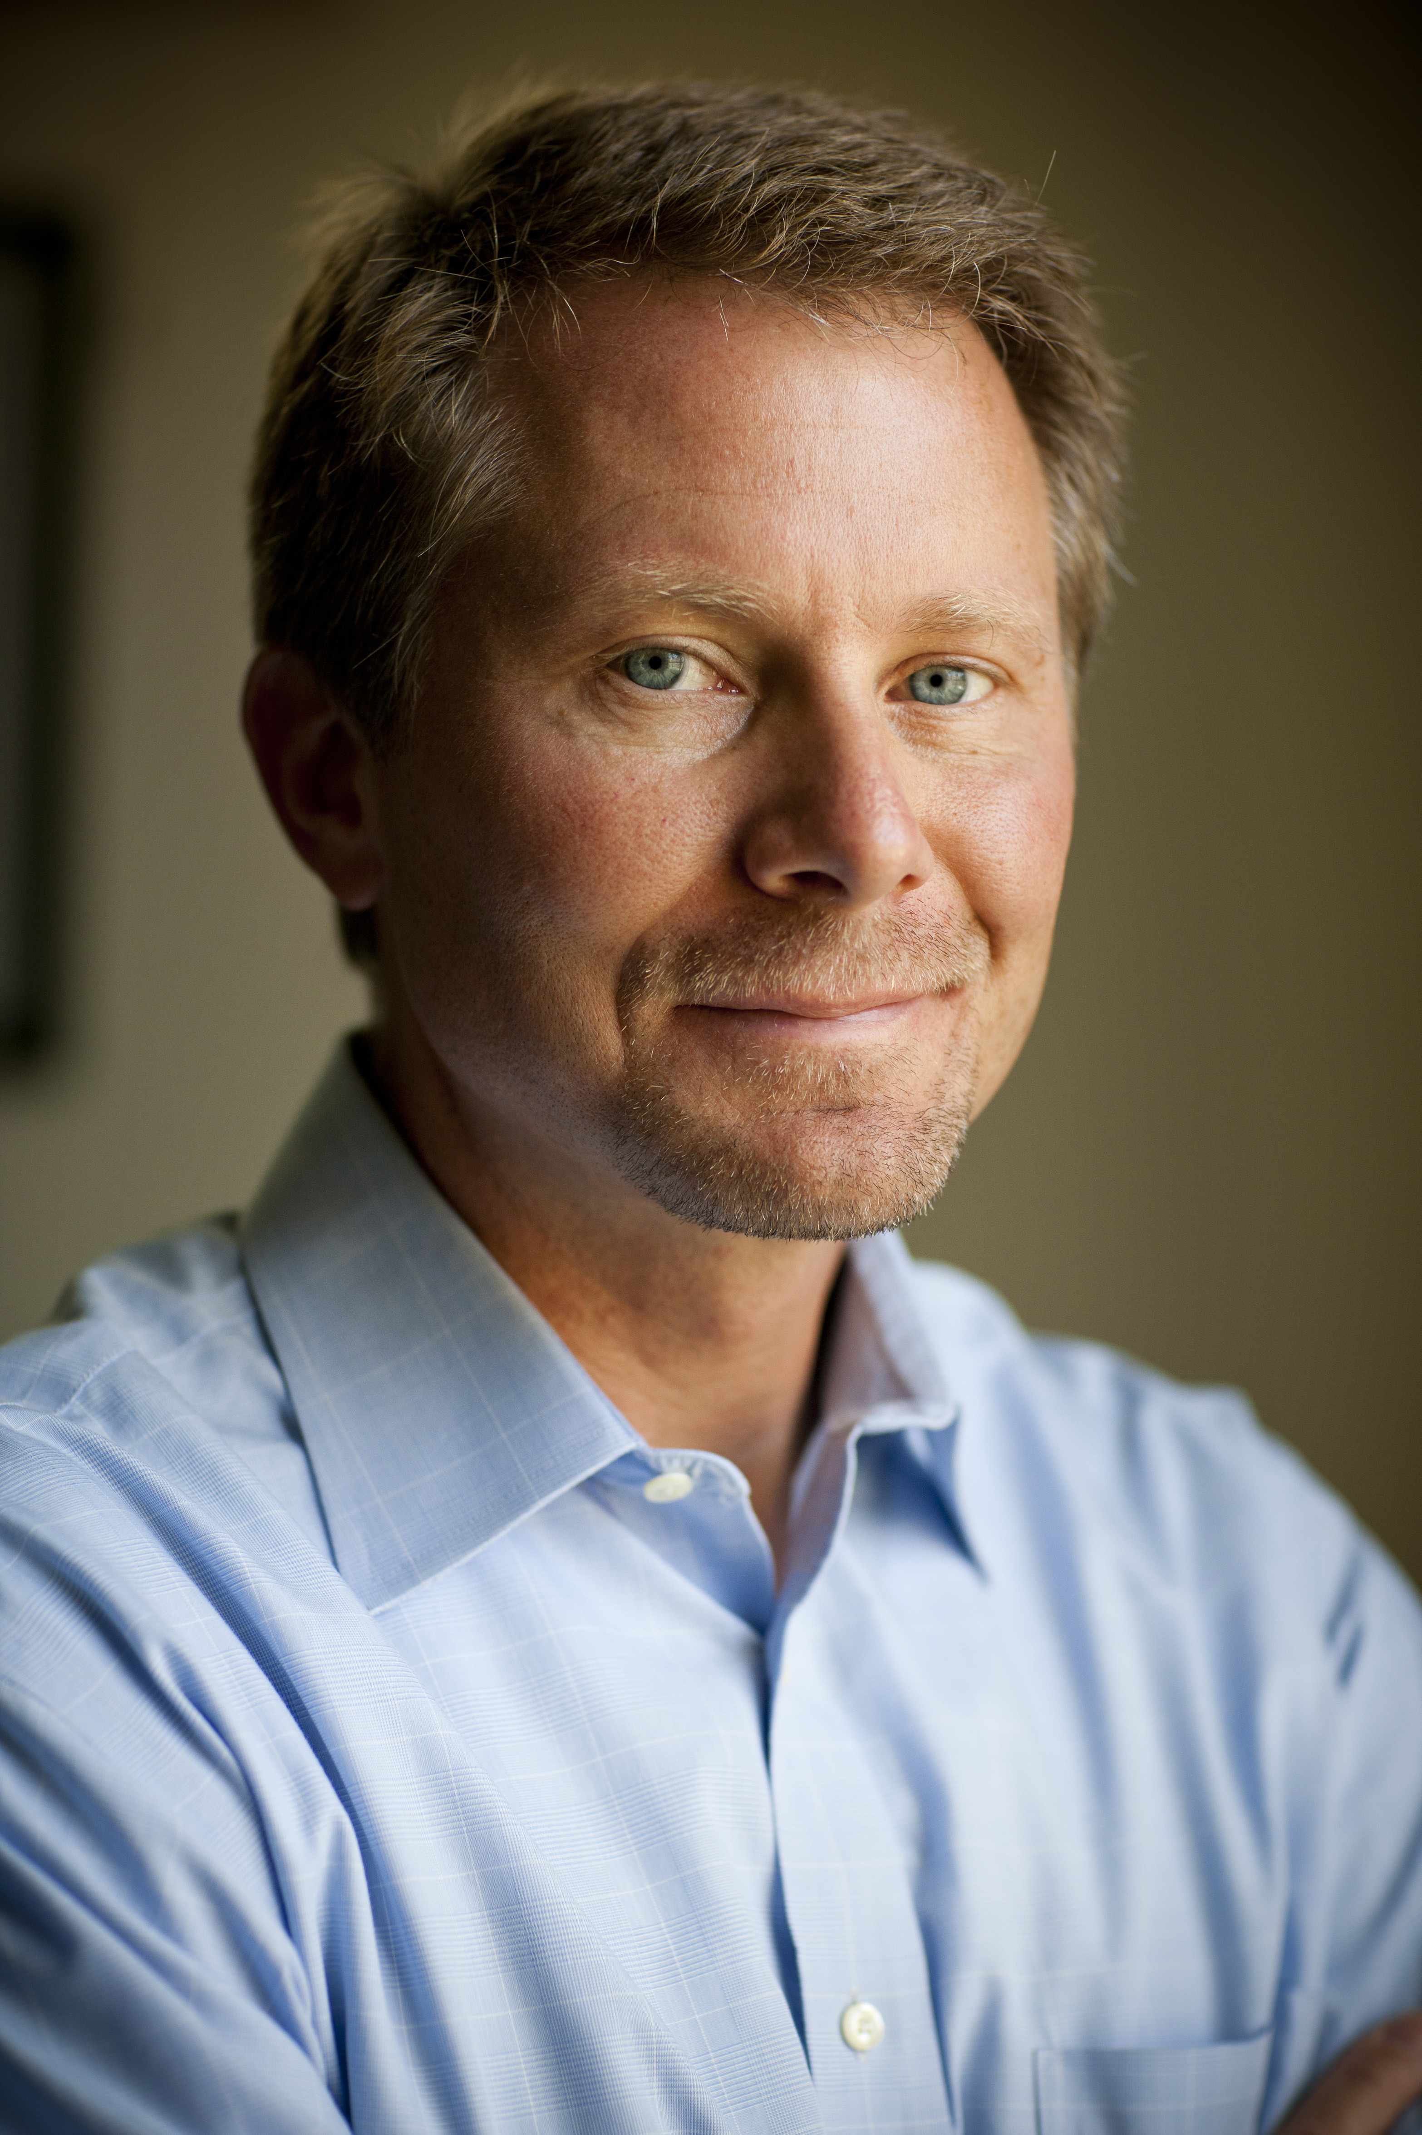
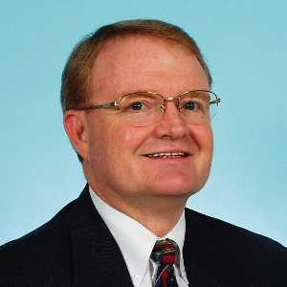
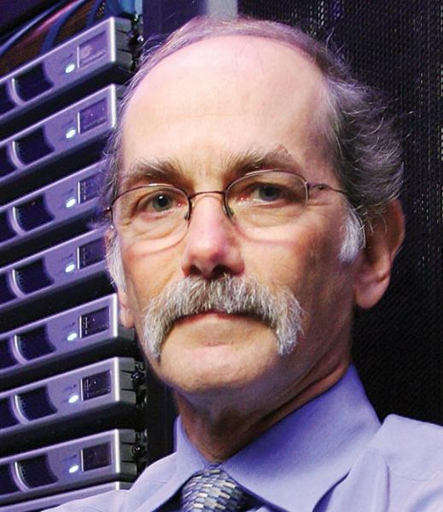
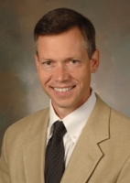
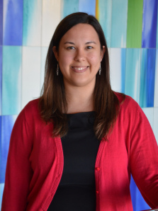
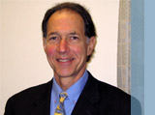
“Dream” Team
Science

Slide 12


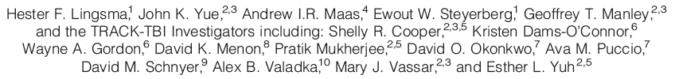
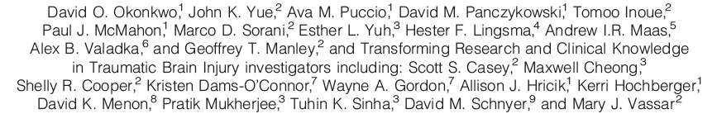
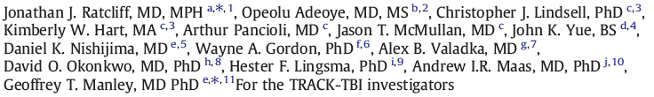
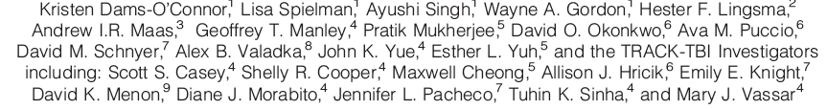
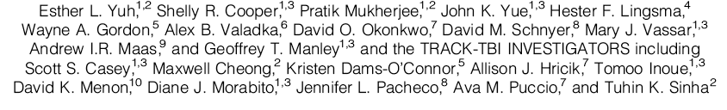
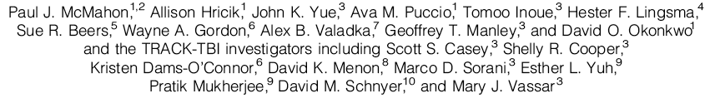


“The Collaboratory”

Slide 13


Slide 14


Slide 15
TBI Endpoints Development Grant - TED
Mission
Connect
CENC
CENTER- TBI
TRACK-TBI
TED
NCAA-
DOD
NCAA-
15 year
CRC
GE-
NFL
ADAPT

Slide 16
Collaboration Experience with TRACK-TBI and TED
Among the Many Benefits of Collaboration
Accelerates research
Increases participation in the field of TBI research
Cross fertilization among disciplines
Innovation
Provides young investigators data source for research opportunity and publication early in career – the future of the field
Relationships formed and lead to further collaboration

Slide 17

Apollo 13: Mission Control
Collaboration

